Slide 1

GirlScript Ireland
Gaming Booster Introduction

Slide 2
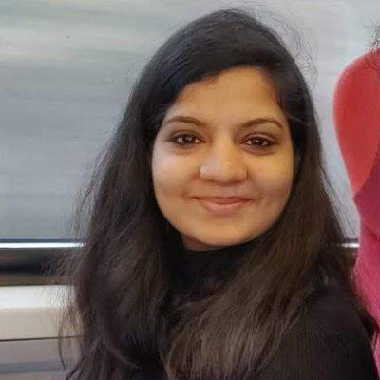
About Me
Reshma Narayanan Kutty
Graduate Student UCD Ireland
linkedin.com/in/reshma-narayanan-kutty/

Slide 3
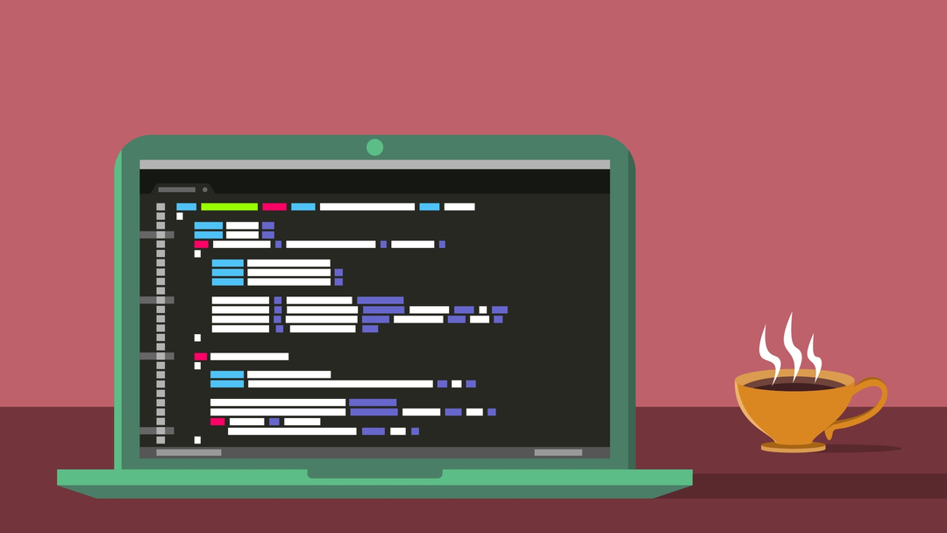
Introduce yourself!
Let’s do a quick round table introduction
Where you’re from
What is your job/uni
What are your hobbies?
What brings you here :)

Slide 4
How it works
4 week program - 1 session per week
Processing (java) /p5.js (javascript)
Flappy bird (Processing) + snake game (P5.js)
Speaker series: Clodagh, Anastasia, Martine(Amazon), etc
Your team will consist of 4 people from different areas

Slide 5
What we’re going to do
WEEK 1
WEEK 2
WEEK 3
WEEK 4
Introduction
Chat
Intro to Processing & Installations
Flappy Bird Using Processing
Snake Game using P5.js
Final bits left

Slide 6

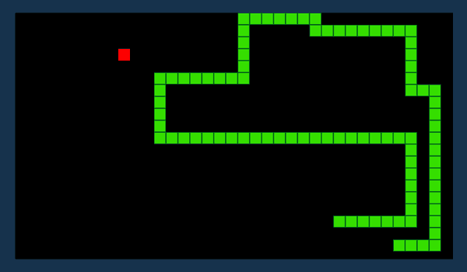
How to make the most of this:
Attend the weekly meetings
Ask questions
Attend the speaker series
Network!
Complete the games

Slide 7
Essentials
Processing.org: Install Processing - https://processing.org/download/
GitHub account (There will be a session on Git)
Willingness to learn :)
References:
Github:
https://github.com/GirlScript-Ireland/Gaming-Booster
Processing:
https://drive.google.com/file/d/1J2IRSm_9cs4imogYqxlOrpKrtheQG6VQ/view
https://processing.org/

Slide 8
Introduction to Processing
Basics: Canvas, coordinates, statements and comments
Basic Shapes: Rectangle, ellipse, line etc
Color: Stroke (Outer), Fill (Inner)
Interact: setup, draw

Slide 9


Slide 10
Any questions?
Notes:
//Smaranjit for genetic algos session as well as the fast pages session with the mentors // GitHub session // GitHub organization

Slide 11
Thank you for attending:)
and welcome to GirlScript Ireland

